Slide 1


GraphQL:
The Devil's
API 👹
Ryan Kuhl
ryan@kuhl.dev
github.com/lame
linkedin.com/in/kuhl
meetup.com
/homebrew-learning-club/
“GraphQL or The Fleeting Interconnectedness of Space and Time As We Collectively Await The Heat Death of the Universe”
Neuharth & Neuharth, 2022
Notes:
TODO:
Get G to work in flask
reset counts at each run
Have all “dials” in one file

Slide 2

The Outline
What is GraphQL
A brief example
Let’s visualize it
Building a GraphQL server
Performance testing (act surprised)
Performance optimization (the good part)
The Good, The Bad, The Ugly
Open source tools
Profit

Slide 3



What the Heck is GraphQL?
GraphQL is three things:
An undirected graph
a query language (QL)
a schema (API)

Slide 4
Let’s Visualize The Graph
GraphQL APIs consist of:
Root (entry node)
Edges
Nodes
“It’s just nodes and edges all the way down. Really makes you think…”
Aristotle

Slide 5
Let’s Visualize A Query
Cars
Brand
GraphQL APIs consist of:
Root (entry node)
Edges
Nodes
Model
Engine
Available
Notes:
Library is our root node
Author: Stephen King
Genre: Horror / Movies
Titles: Short Stories / The Shining
Locations: Salt Palace SLC

Slide 6
Query
Language
query EvilCars{
brand(name: "Lamborghini"){
model(name: “diablo”){
edges{
node{
engine{
edges{
node{
cylinders
is_evil
available{
city
state
}
... (so many brackets)
}
A descriptive structure of our API
DENSE queries
Replaces all those swagger docs
Typesafe (JSON types)
Freebies like cursor, first, after, and __typename
Autocomplete in GQL Clients
Notes:
The GQL Query language creates a self-documenting, typesafe, easy to explore API
Highlighted are our nodes
Connections between nodes do not necesairily need edges/node, it depends on the schema

Slide 7
Why the Edges & Nodes?
query EvilCars{
brand(name: "Lamborghini"){
model(name: “diablo”, first: 2){
pageInfo{
hasNextPage
}
edges{
cursor
node{
engine{
edges{
node{
cylinders
... (so many brackets)
}
Connection: a relationship between a node and other nodes
Edge: The line connecting two nodes
Cursor based pagination
“Cursor-based pagination is the most efficient method of paging and should always be used where possible.”
- Meta Developer Docs
Notes:
The GQL Query language creates a self-documenting, typesafe, easy to explore API
Highlighted are our nodes
Connections between nodes do not necesairily need edges/node, it depends on the schema

Slide 8
The Schema
class LamborghiniQL(SQLAlchemyObjectType):
class Meta:
# Connect SQLAlchemy & GQL schema
model = LamborghiniModel
interfaces = (relay.Node,)
# GQL Property not in SQLA Model
is_evil = graphene.Boolean()
# How to resolve is_evil property
def resolve_is_evil(self, info):
# self is the SQLA model instance
return self.model_name == 'diablo'
Instantiates nodes and connections (edges)
Connects nodes to SQLAlchemy models
Typesafe properties
Resolvers for GQL properties that are not model properties
Notes:
Graphene-SQLAlchemy connects our SQLAlchemy model and GQL schema
graphene.Boolean() creates a typesafe interface
Resolver is logic for custom properties on GQL schema
Self is the SQLA instance

Slide 9




Pit Stop: GraphQL Packages
We need three things:
1. Database
2. ORM
3. GQL Lib

Slide 10

Pit Stop: Database
You can use any database
Relational (eg. Postgres)
NoSQL (eg. Cassandra)
Graph (eg. neo4j)
GraphQL schema creates a graphical representation façade on any database
Notes:
MongoDB is a bad database

Slide 11

Pit Stop: ORM
SQLAlchemy
Industry standard from my experience
Peewee sounds cool, but I haven't used it. Maybe for Pycon 2023!

Slide 12
Pit Stop: Python / GraphQL Libs
Ariadne
Pronounced "R-E-ad-knee", from greek mythology 🤷
1.7k stars, 45 contributors on GitHub,
Graphene
Easy to pronounce, named after super rad game-changing material 👈
7.1k stars, 162 contributors on GitHub

Slide 13
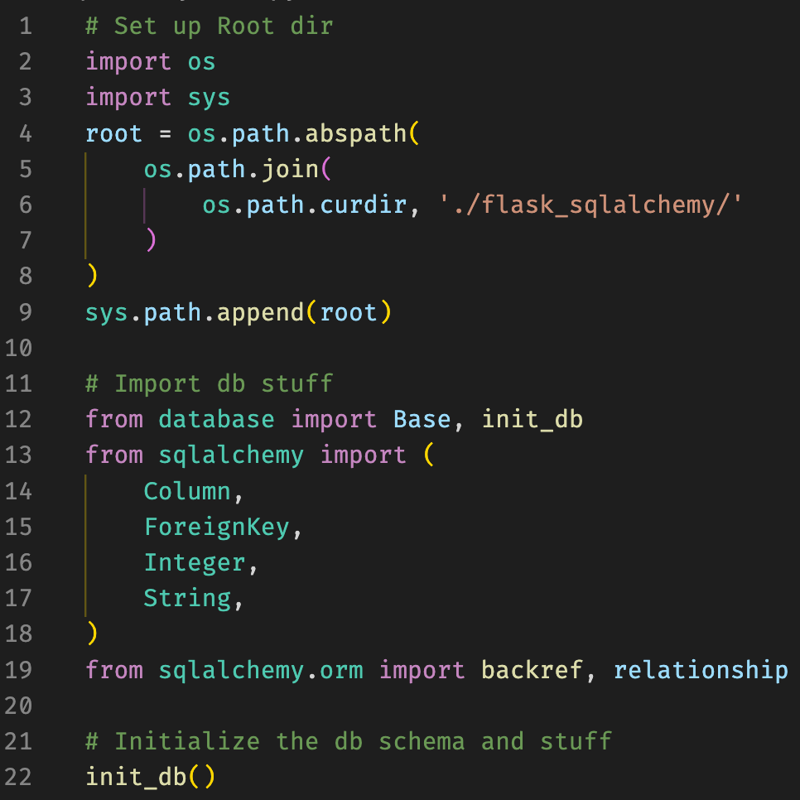
Let's Make A GraphQL Server:
Models
Let's Make A GraphQL Server:
M
Boilerplate 😵‍💫

Slide 14
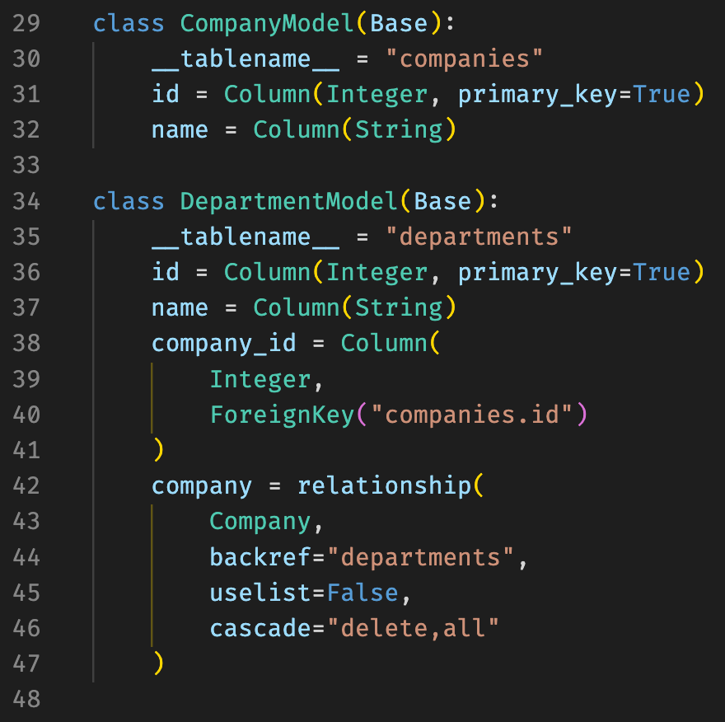
Let's Make A GraphQL Server:
Models
Let's Make A GraphQL Server:
M
Create our SQLA models w/ 1:M relationship

Slide 15
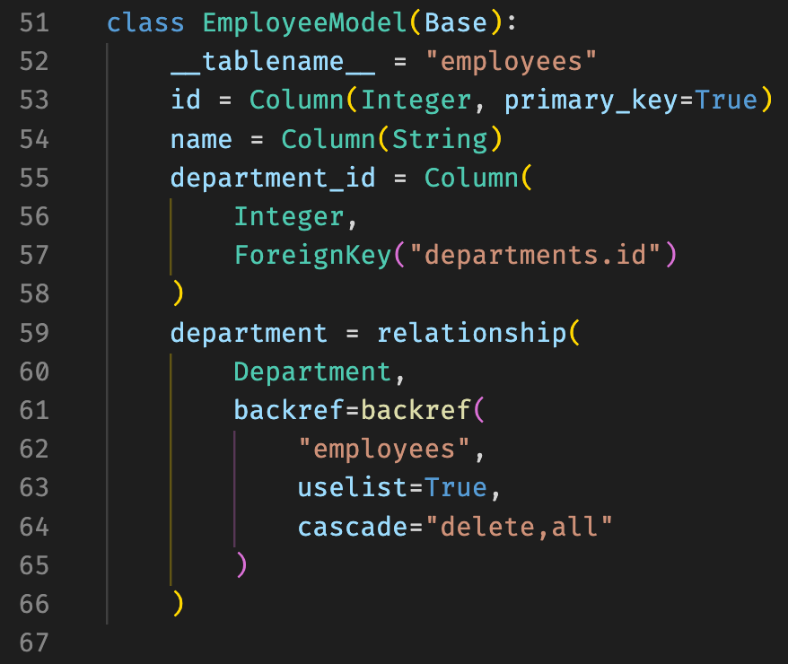
Let's Make A GraphQL Server:
Models
Let's Make A GraphQL Server:
M
Create our SQLA models w/ 1:M relationship

Slide 16
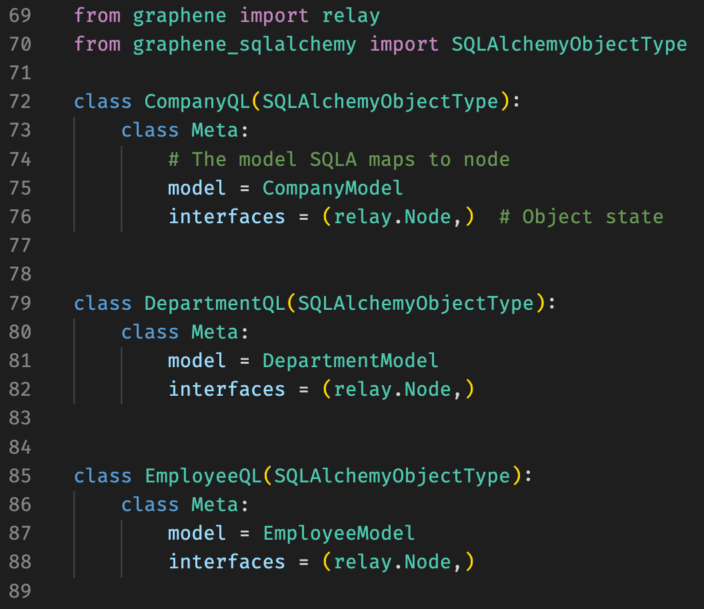
Let's Make A GraphQL Server:
Schema
Create our nodes!

Slide 17
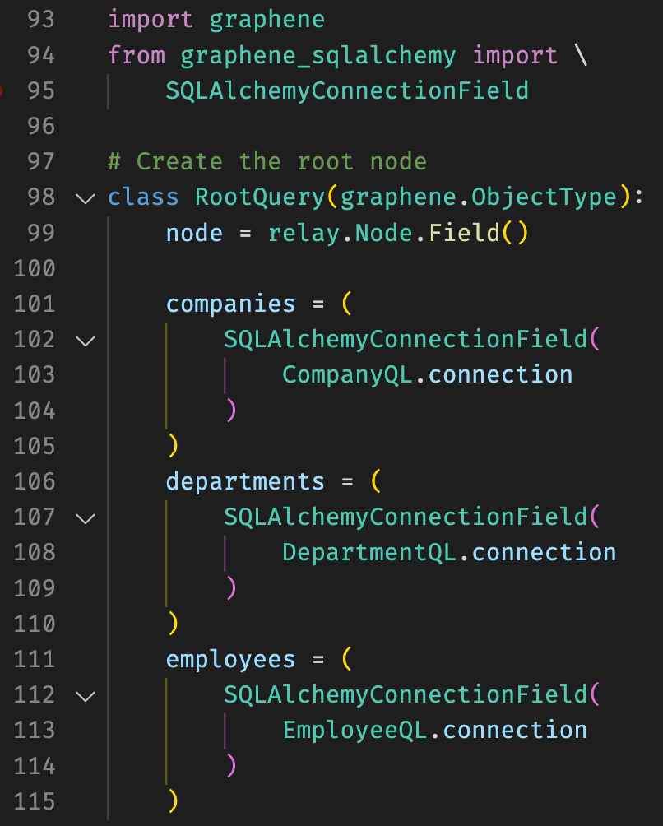
Let's Make A GraphQL Server:
Schema
Let's Make A GraphQL Server:
Schema
Create our root!

Slide 18
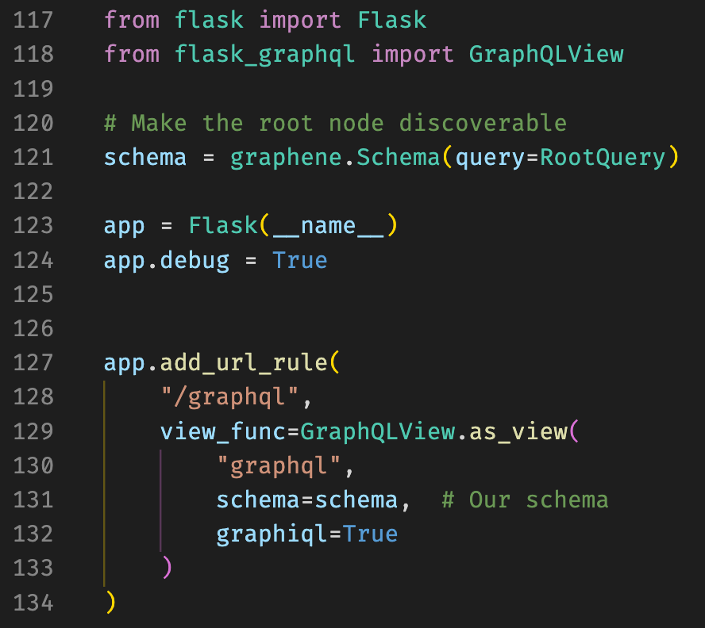
Let's Make
A GraphQL Server:
Schema
Let's Make A GraphQL Server:
Schema
— code block —
# Make the root node discoverable
schema = graphene.Schema(query=Query)
app = Flask(__name__)
app.debug = True
app.add_url_rule(
"/graphql",
view_func=GraphQLView.as_view(
"graphql",
schema=schema,
graphiql=True
)
)
— end code block —
Create our Flask view!

Slide 19

Live Demo Time!
What could go wrong?
Notes:
Don’t forget to add latency at the end!!!!

Slide 20
The Devil 👹
is in the Details Latency
GraphQL's contextual ladder of context
— should look like a ladder —
|
|- Company
|-- Departments
|--- Employees
|
— end super sweet ladder —
Even small queries can pose performance issues
Local development can be deceptive as remote dbs have a non-trivial request cycle
What is an ORM execution event?

Slide 21
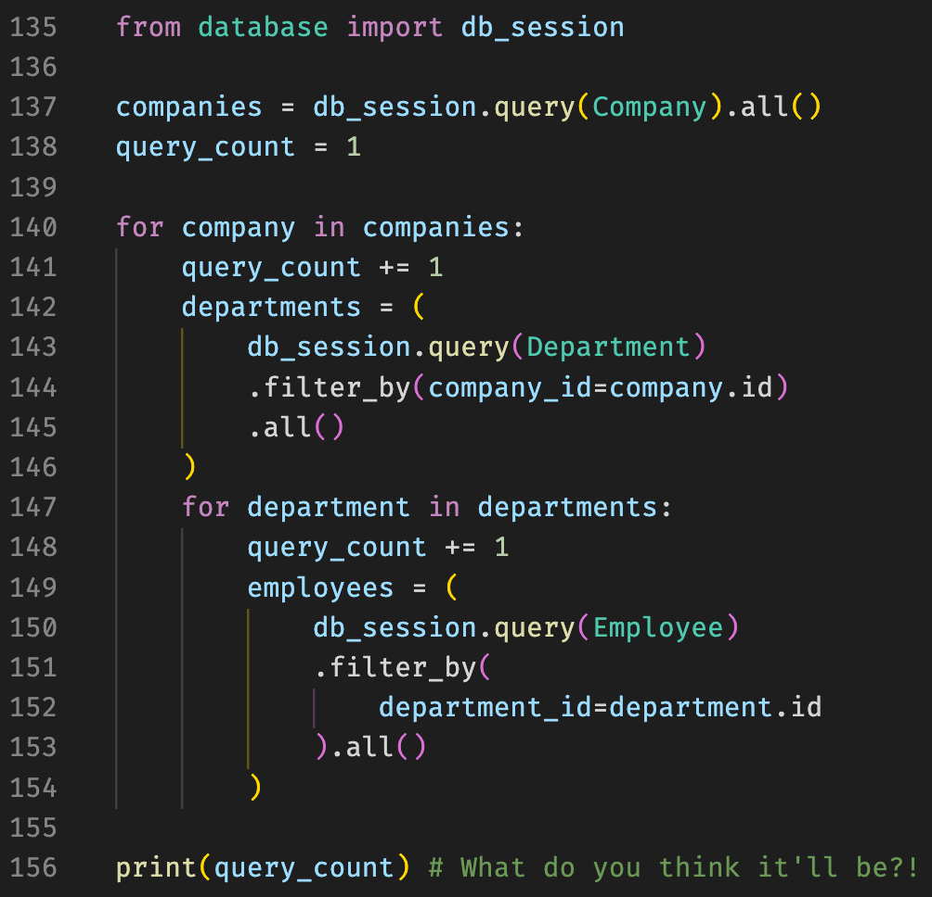
Python Equivalent
For-loops everywhere 🤯

Slide 22
The Math of N+1 Queries
1 company
10 departments
100 employees
1 (1 company)
+ 1 (1 company / 10 departments)
+ 10 (10 department / 100 employees)
= 12 events
100 companies
1k departments (10/company)
100k employees (100/department)
1 (100 companies)
+ 100 (100 companies / 1k departments)
+ 1k (1k departments / 100k employees)
= 1101 events 😨

Slide 23

DataLoaders To the Rescue!!!
We don't need to do independent queries at each level. We can batch them!
Up next:
Promise
Creating a batch load function
Performance validation

Slide 24
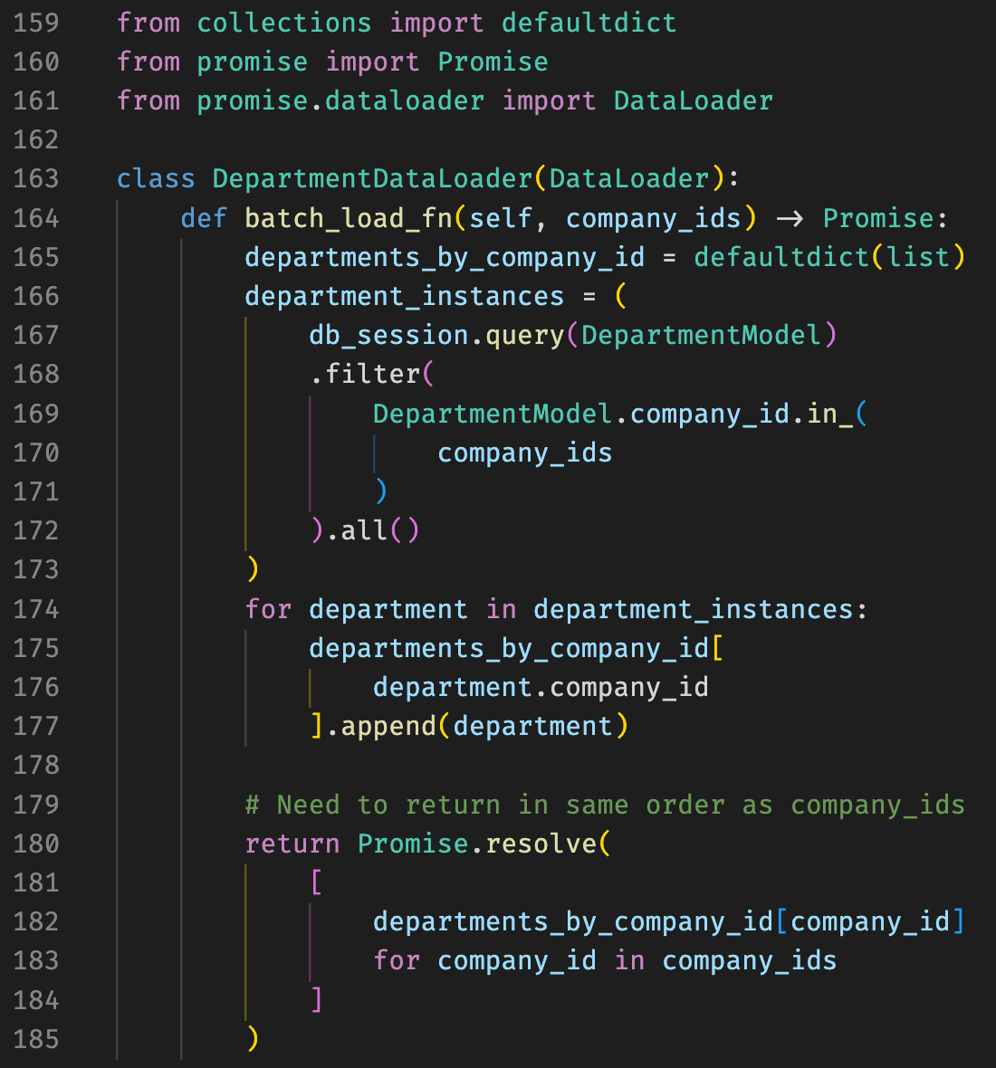
The Devil 👹 is in the Complexity
Dataloaders require in-depth understanding of:
Database(s)
ORM
GraphQL core concepts
Python Async
Notes:
Debugging becomes very difficult
Don’t talk about the code specifically, this is an example of a dataloader!!

Slide 25
What the Heck is a Promise?
Introduce some async to our process.
Sort of like generators:
Resolver requests some object
Resolver queries DataLoader for obj
DataLoader returns a Promise()
Promises are lazily resolved by Dataloader.batch_load_fn()

Slide 26
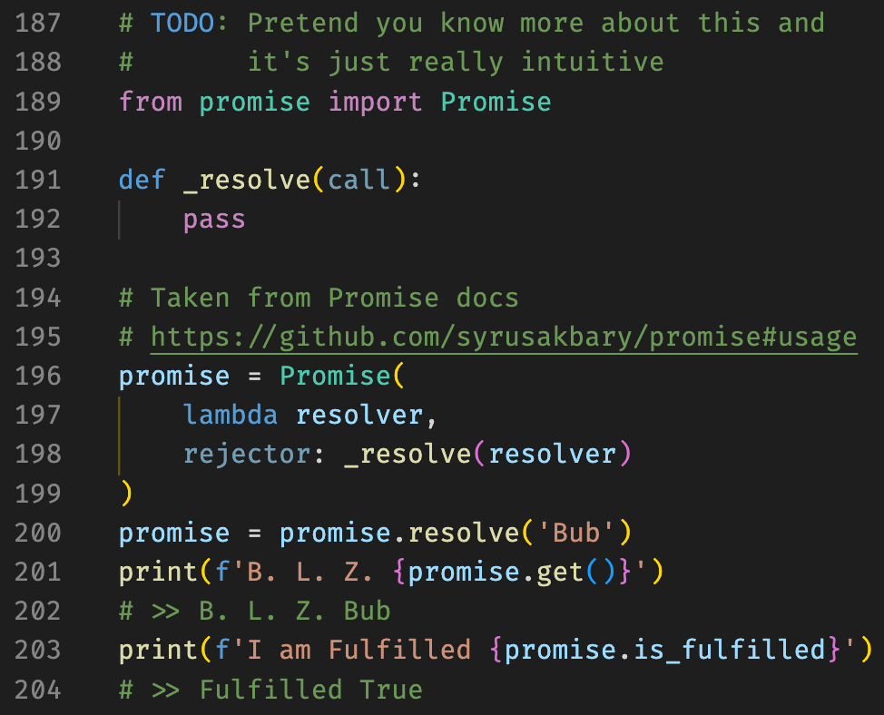
I Promise This is Just An Example:
- Resolve
“I promise I’ll let you on the door in a minute, Jack”
- Rose

Slide 27
Let’s Make a Dataloader
Caveats:
This is a very simple dataloader
Promise.resolve needs to be in the order of the method argument
Optimizations are directional
Filters need to be built into ORM query in the batch_load_fn

Slide 28


Let's See Our DataLoader Gainz 💪
Back to live demoing, pray for me 🙏

Slide 29
Key Takeaways
The Good 👼
Descriptive and explorable API
Only the attributes you need
Dense queries reduce queries per second
Shifts load from python to DB
Performant when optimized
DataLoaders aren’t that bad in the grand scheme of things
Easily parsable return types
Pagination is built in
Strongly typed
Root nodes make auth easy

Slide 30
Key Takeaways
The Bad 👹
GraphQL servers add significant complexity to backend development
Simple queries can slow performance
N+1 is exposed to users (not specific to GQL)
Deep knowledge of the underlying database is crucial
Versioning is fuzzy

Slide 31
Key Takeaways
When to use GraphQL
Prioritize a great user-experience (querying)
API is getting bogged down
(too many queries per second)
Façade over database / legacy REST API
You crave a challenge in life

Slide 32
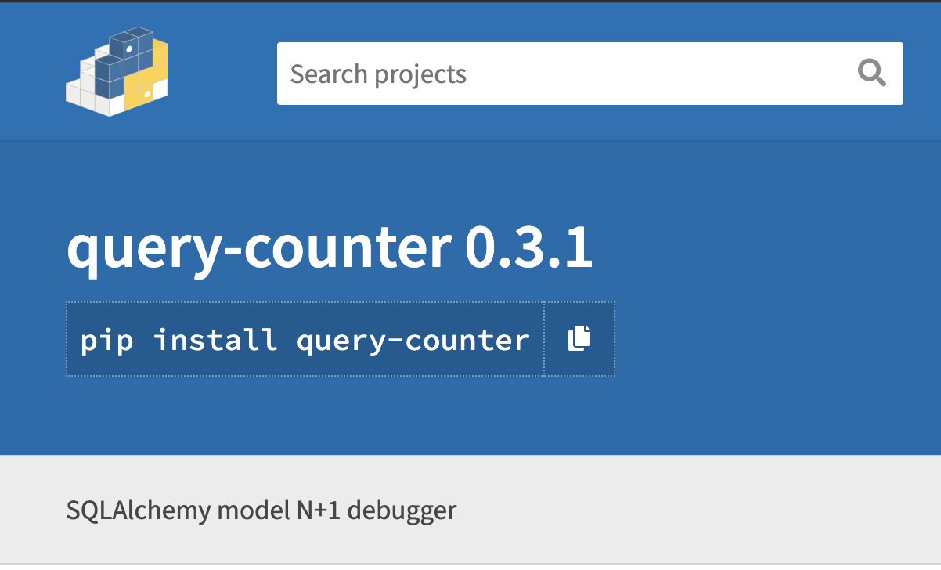
Open Source Tools
Query Counter on PyPI by Brian Oleki et. al

Slide 33
Shout Outs
David Hwu
Henry Zhang
Ryan Farjadi
David Finlay
Mark Glowski
Song Chang
BAyPIGgies meetup (& Jeff F.)
Sep Dehpour
Pierre Brousseau
Trung Ly
Special thank you to Tatari check out their booth in the expo hall and during the career fair!!

Slide 34
Talk tech with me!
Bay Area Python Interest Group - BAyPIGgies (meetup)
Homebrew Learning Club (meetup)
SoCal Python (meetup)

Slide 35

✌️
Ryan Kuhl
ryan@kuhl.dev
github.com/lame
linkedin.com/in/kuhl
meetup.com
/homebrew-learning-club/
Notes:
Time for questions!

